Slide 1
Geospatial and open-source intelligence Cybersecurity capstone plan
Ron Harush
November 2, 2023

Slide 2

Theoretical Part
GEOINT and OSINT overview
Regulations (law and policies)
Satellite images of Gaza to demonstrate GEOINT capabilities

Slide 3
Technical part - Photo GPS Locator Tool
GUI (Streamlit)
User Authentication
GPS
Encryption - Not relevant

Slide 4
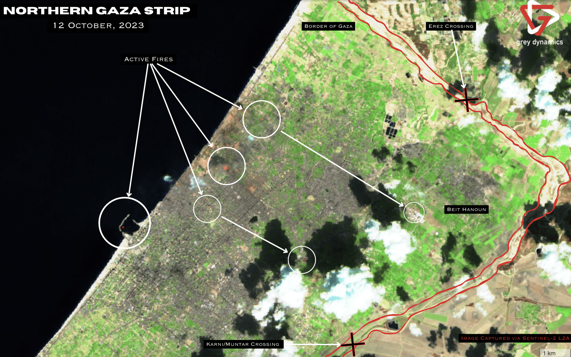

Slide 5
Thank you

